Slide 1
Moral Machine
Applications of Heuristics as a Scientific Methodology on Military, Medical and Industrial Fields.

Slide 2

INDUSTRY:

Slide 3
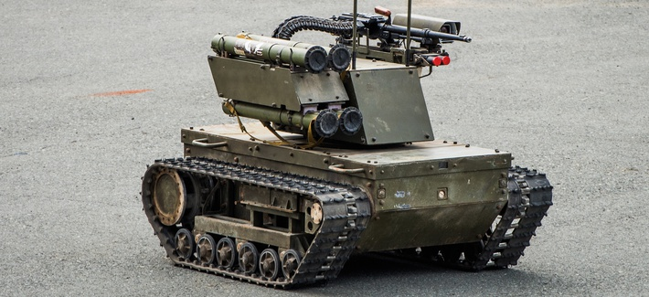
MILITARY:

Slide 4

MEDICAL:

Slide 5
CONCLUSION

